Slide 1
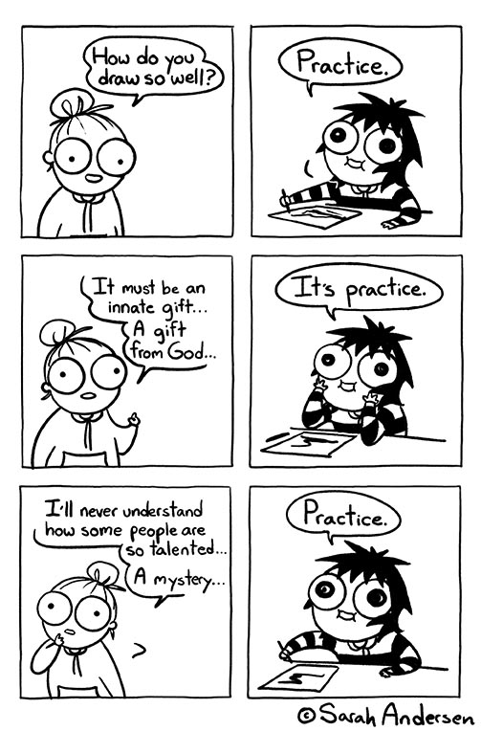
User Interface Design

Slide 2
UI Week 2: Wednesday
Dr. Jillian Aurisano
Plan for today:
Announcements/Course logistics
Why sketch
Sketching activity
Notes:
So welcome to engineering visual interfaces for data science. I'm Dr Aurisano.
Thanks for finding the class on Zoom. Hopefully we will be in person again soon.
If anyone out there is comfortable turning on their cameras, that is lovely- then I feel like I am talking to students, rather than to myself.
Here’s our plan for today:
First I’m going to introduce myself, so you know a bit about me
Then we are going to get to know each other, in Zoom breakout rooms. This will give us a chance to make sure that Zoom breakout rooms work, and we all know how to access them.
Then, I am going to walk through the structure, and plan for the course. I want to make sure everyone knows how the course will work, and what to expect, and also a bit about why the course is designed this way.
Then I am going to introduce the class, and what the class is about. Since this is a new class, and one of just a few classes in human centered computing here at UC, I wanted to give an overview of the topic.
Then I have an introductory activity, which we will do in breakout rooms, and which I think will help motivate the discussion on Wednesday, and getting into the meat of the class.

Slide 3
Announcements / Course logistics
Sketching activities
SAVE YOUR SKETCHES!
Homework 1- how did it go?
Coding support today after class
Also TA Colin has office hours
Homework 2- posted
Project 1- questions
Note- use Svelte not SvelteKit
Why….

Slide 4
Today: let’s start sketching!
Sketching is VERY important in design
At multiple stages in our design process
We left off at needs finding, requirements gathering
We did interviews to find out what we want our designs to do
What’s next? How do we explore these design challenges?
Sketching to explore design possibilities

Slide 5
Sketching for brainstorming
Refer to Chapter 1 (especially 1.4) in Sketching User Experiences workbook
Suppose you have a design challenge you want to explore for a project
How can you use sketching to explore this challenge?

Slide 6
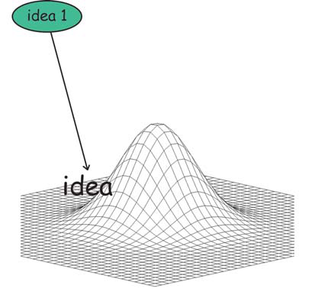
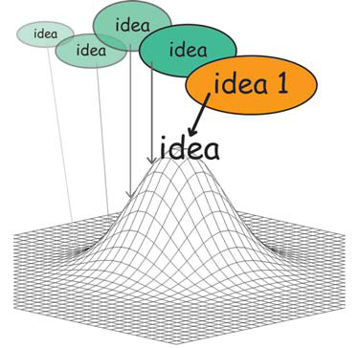
We may be tempted to think: Let’s get the design right
Suppose you have an idea
Then you iterate on it, to develop it
As you develop it, the idea will get better
“Getting the design right”
Improving the design idea

Slide 7
We may be tempted to think: Let’s get the design right
But is it the best idea?
Suppose you have an idea
Then you iterate on it, to develop it
As you develop it, the idea will get better
“Getting the design right”
Improving the design idea

Slide 8
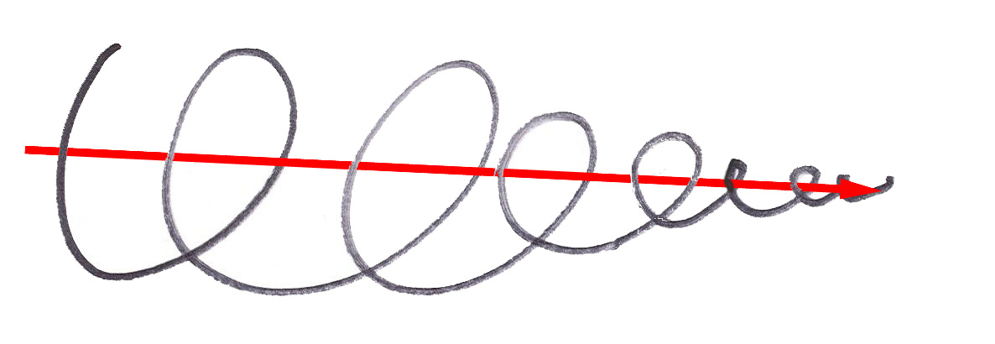
Getting the design right
Exploiting a single idea will propel you down a path toward a single convergence point
How do we know this is the “best” direction to go?

Slide 9
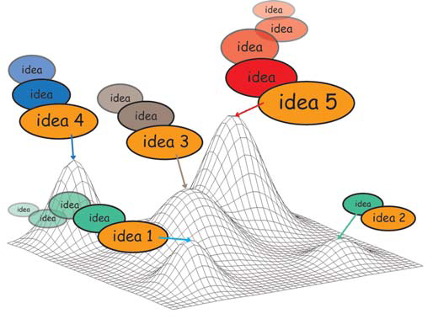
Getting the Design Right: The problem
fixates on first idea
local hill climbing issue did you reach local vs. global maxima?

Slide 10


Example : Cell phone design
Consider cell phone design
For years: physical keyboard, with physical keys
There were improvements within this initial design
But, a new idea (what if there was no physical keyboard?) opened up lots of new possibilities

Slide 11
Example : Cell phone design
Could we have developed the touch screen cell phone by just iterating on the physical keyboard cell phone?
Maybe…. Probably not….

Slide 12
Getting the Design Right vs Getting the Right Design
Important phrase in design and UI design
Getting the design right, is taking an idea and developing it
“Let me get this design right”
Getting the right design, is identifying a good design idea from many possible design ideas
”Let’s explore and find the right design”

Slide 13
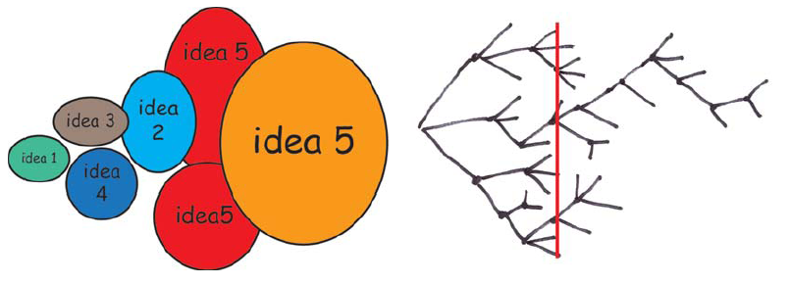
Getting the Right Design
generate many ideas and variations
reflect on all ideas
choose the ones that look most promising
develop them in parallel
add new ideas as they come up
then iterate your final choice

Slide 14
Another way to think about it: Elaboration and Reduction
Design process is a symbiotic relationship between elaboration and reduction
Elaboration: generate ideas, these are different opportunities
Reduction: decide on the ones worth pursuing, and then elaborate on those solutions
Elaboration opportunity seeking
Reduction decision-making
Design process
Source: Laseau,P. (1980) Graphic Thinking for Architects & Designers. John Wiley and Sons

Slide 15
Where is creativity?
Be creative in enumerating meaningfully distinct options from which to choose
Be creative in defining the criteria or heuristics that will help you make your choices in which designs to develop

Slide 16
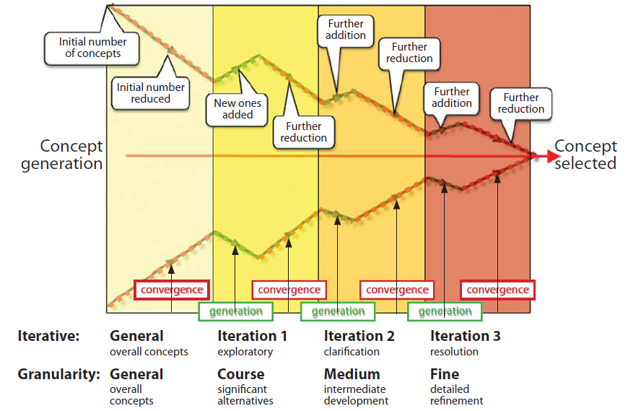
Design funnel
Alternate generation of ideas and convergence until resolution
Modified from Pugh, S. (1990) Total design: Integrated methods for successful products engineering. Addison-Wesley. P. 75

Slide 17
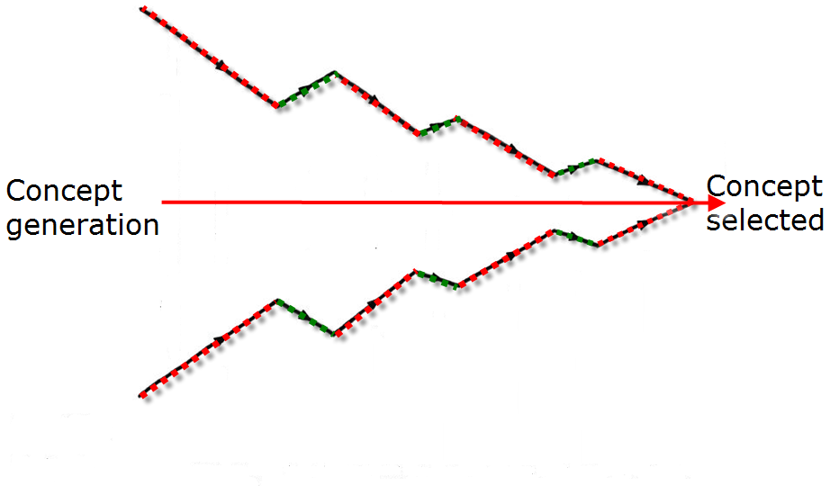
Practices for descending the design funnel
We need to develop practices that will help us explore design possibilities
10 plus 10 method

Slide 18
10 plus 10 method
1. State you design challenge
2. Generate 10+ designs that address that challenge
3. Reduce the number of design concepts
4. Choose the most promising concept(s)
5. Produce 10 details /variations
6. Present and get feedback
7. Refine, repeat, continue down the design funnel

Slide 19
Variation on 10-plus-10
If producing 10 novel sketches is hard, 10 minutes plus 10 minutes
Sketch for 10 minutes
Reduce, refine
Sketch for 10 minutes

Slide 20
1. State your design challenge
A design challenge is:
a particular problem you want to solve,
a particular need you want to address,
a particular possibility raised by a new technology
Be specific
Example: Suppose you are creating an app to share photos between people who are in the same physical area
NOT specific: an app to enable people to share photos when they are in the same physical area
Specific: enable two people to activate a connection between their devices without a long or complex authentication protocol

Slide 21
2. Generate (Sketch) 10 ideas
This is like brainstorming
Goal: Be creative and diverse. No judgement!

Slide 22
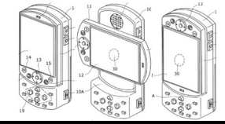
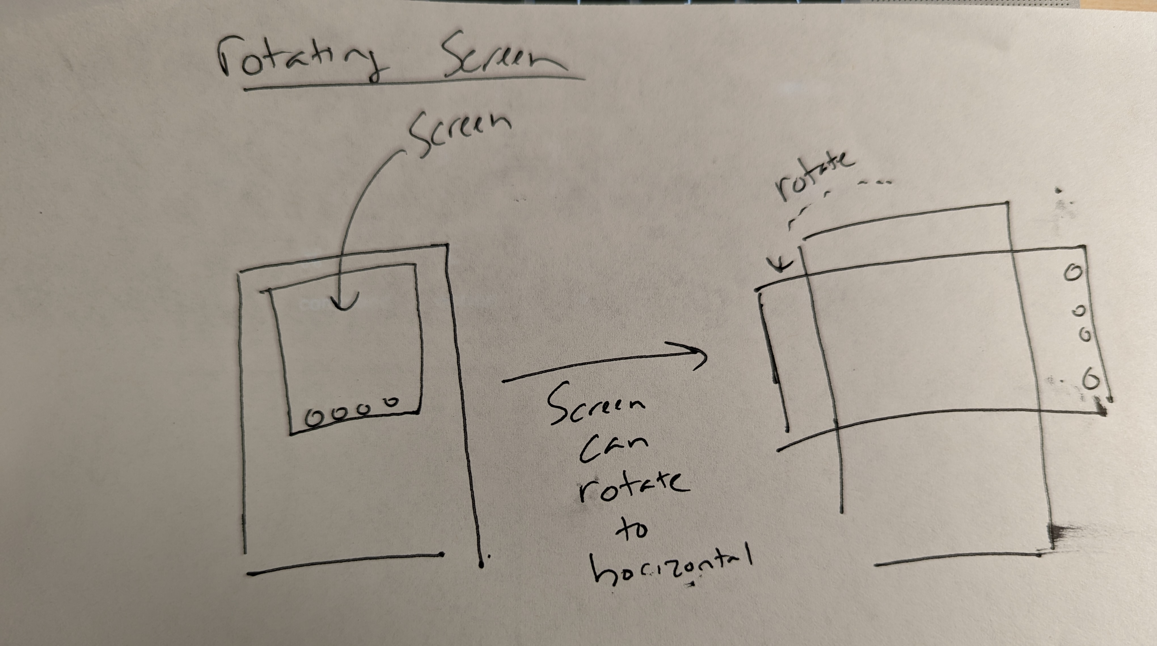
2. Generate (Sketch) 10 ideas
Not this:
Quick sketches:
Minimal detail – can just include what is required to express the concept
Not the time to sketch what the UI looks like in detail
Not the time for elaborate storyboarding
No need to be an artist
Can include annotations or text description
Why is this potentially better?
But this

Slide 23
2. Generate (Sketch) 10 ideas
Not this:
Quick sketches:
Minimal detail – can just include what is required to express the concept
Not the time to sketch what the UI looks like in detail
Not the time for elaborate storyboarding
No need to be an artist
Can include annotations or text description
Why is this potentially better?
Sketch many ideas!
Sketch in a way that leaves an opening for the design funnel to refine
But this

Slide 24
3. Reduce the number of design concepts 4. Choose the most promising
Some concepts may stand out as less promising, or less useful
It can be hard to discard ideas, but you have to winnow at some point
Which concepts are the most promising
Note down if you have criteria you are using for winnowing ideas

Slide 25
5. Produce 10 details and/or alternatives
This may mean adding more details:
Break your idea down into more steps
Take an aspect that is hazy, and try supplying more details
It may mean exploring alternatives from the starting point
The goal is to elaborate in different ways and explore alternatives

Slide 26
6. Present your ideas to a group
At this stage- other designers….
Get some feedback- look over the ideas and discuss
Ask for suggestions

Slide 27
7. Refine, repeat

Slide 28
Practice
Designing an app so people can share things with someone nearby
1. State your design challenge:
How can two people connect their mobile devices for information exchange (e.g., photo transfer) without resorting to dialog boxes or other tedious interface requests?
Assumptions
mobile device detects nearby phones
they can initially do some limited communication
you and the person can perform some action that both phones recognize as a ‘handshake’ affirming a full connection is desired

Slide 29
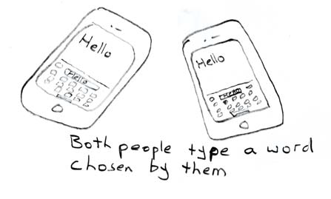
2. Generate 10 competing concepts
1. Enter a keyword

Slide 30
Now you!
Find a partner
Go to canvas and open sketching activity 1 under week 3
Generate 10 competing concepts together
BUT- both people must generate 5 sketches. Let’s ALL practice.
We will reconvene to discuss what we came up with
THEN we will do an elaboration step with one concept, and elaborate

Slide 31
Note about ‘10’
Last year:
Difficulties coming up with 10 alternatives, and 10 drill-down explorations for a given challenge
Do your best to do 10
If struggling: 10-minutes-plus-10 -minutes
Sketches very detailed
Remember- keep it simple
Want to start with words
That’s ok. Just do some sketching to flesh it out.

Slide 32
Our project
In a small group,
Identify some design challenges with your tracking and journaling application
Would you be able to elaborate on these through sketching?

